Slide 1
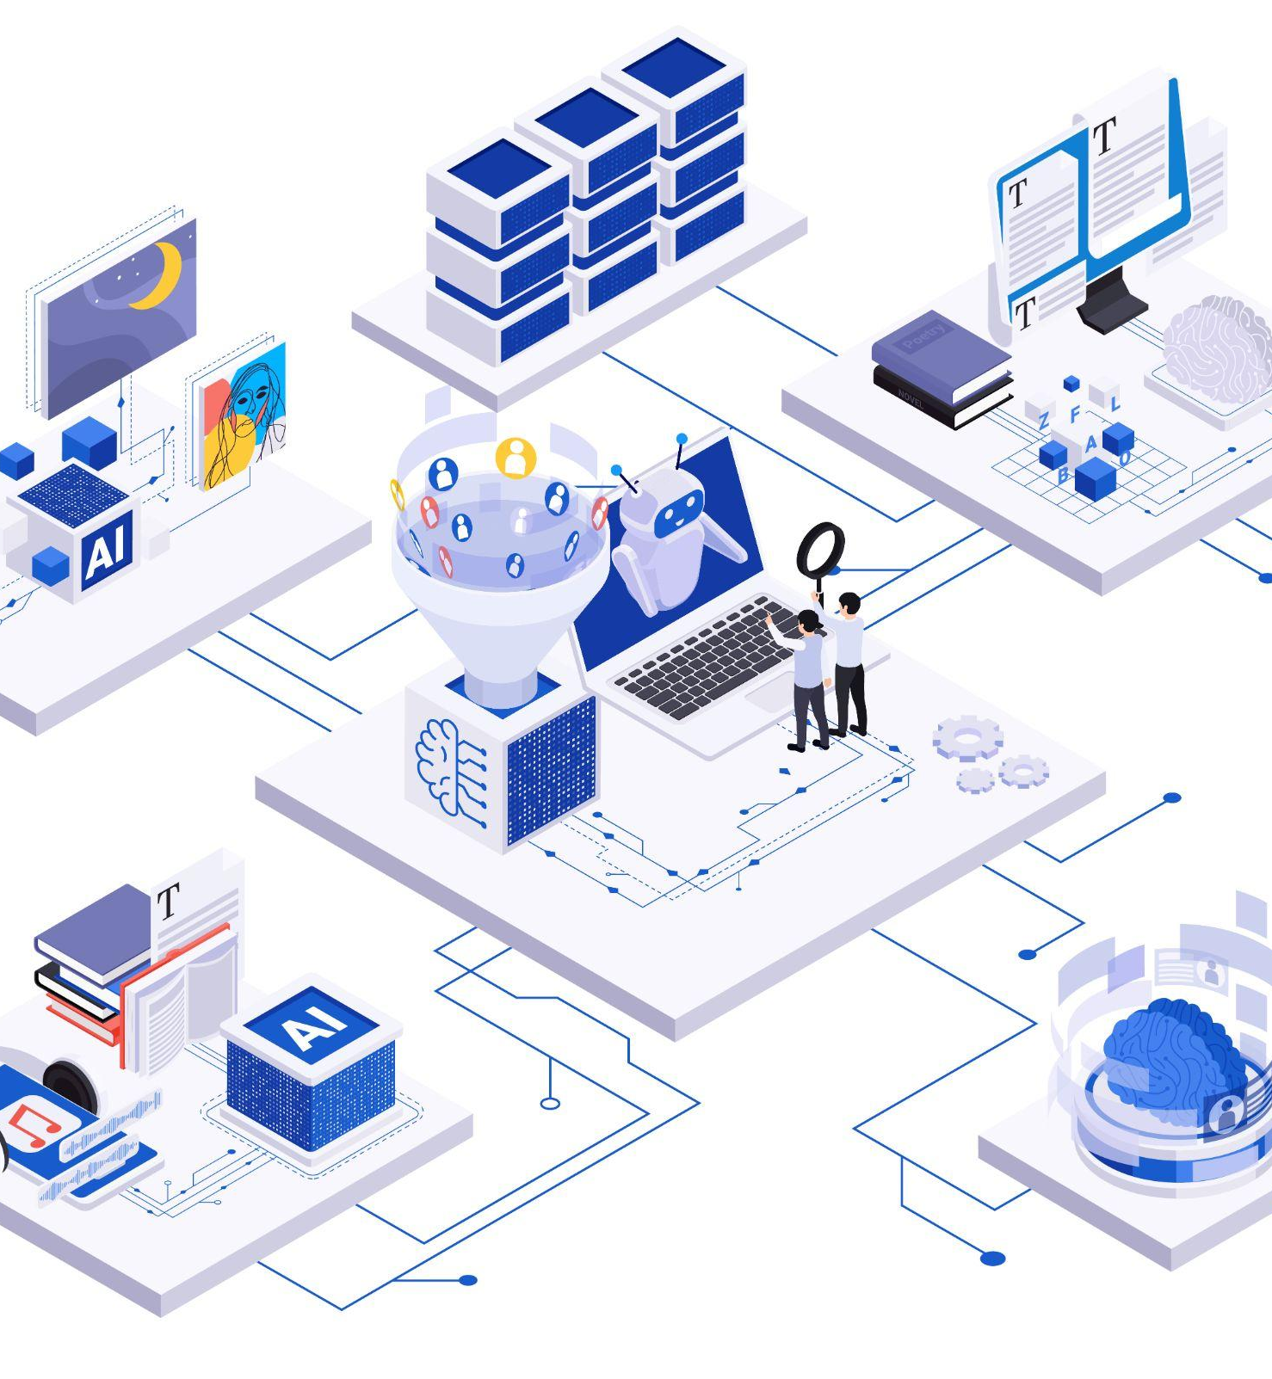
Databases for GenAI
Embeddings, Vector Databases & Production Patterns
October 2025

Slide 2

Speaker
Maksym Lypivskyi
Head of Cloud Platforms & AI Director
9 years at Ciklum driving large-scale cloud and software delivery initiatives
3 years specializing in AI
Core interest: making AI systems reliable, production-ready, and business-impactful

Slide 3
Agenda
01
Foundations
02
Advanced RAG patterns
03
Production readiness
Notes:
Today's Deep Dive:
01 | FOUNDATIONS & PERFORMANCE
• What are embeddings and similarity search
• 2025's best embedding models
• Vector database benchmarks: PostgreSQL, Qdrant, Pinecone
02 | ADVANCED RAG PATTERNS
• Graph RAG: Multi-hop reasoning across documents
• Multimodal RAG: ColPali for visual documents
• Agentic RAG: Dynamic intelligence and self-correction
03 | PRODUCTION READINESS
• Hybrid search + reranking (the 2025 baseline)
• Do's and Don'ts
• Live demo + Q&A

Slide 4
Foundations

Slide 5
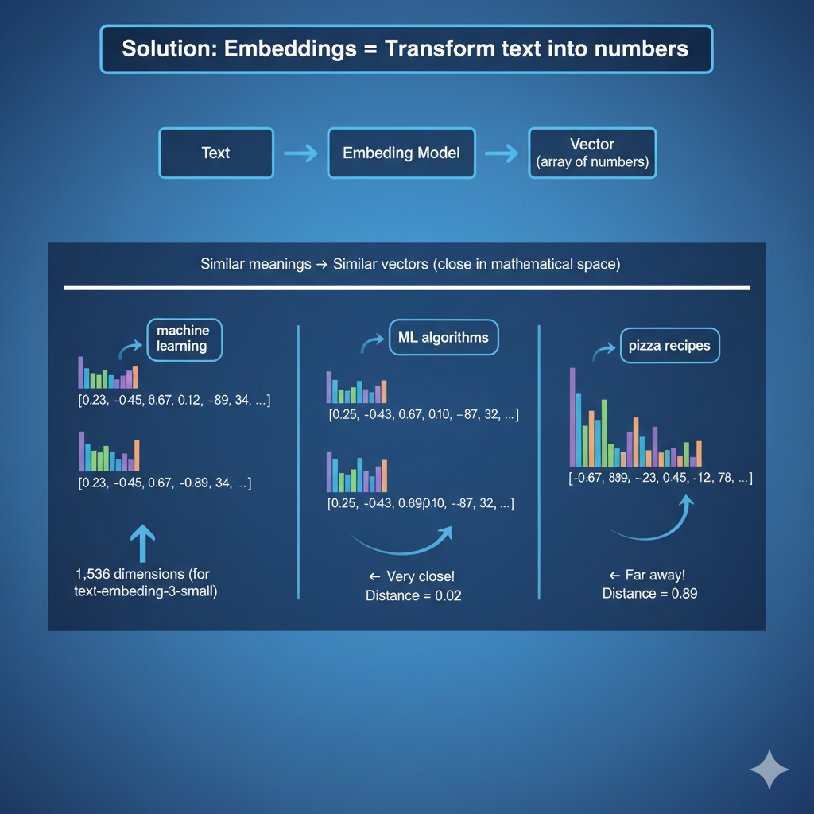

What Are Embeddings?
The Problem: Computers don't understand text meaning
"machine learning algorithms"
"ML techniques"
"deep neural networks"
Are these similar? How do we compute that?

Slide 6
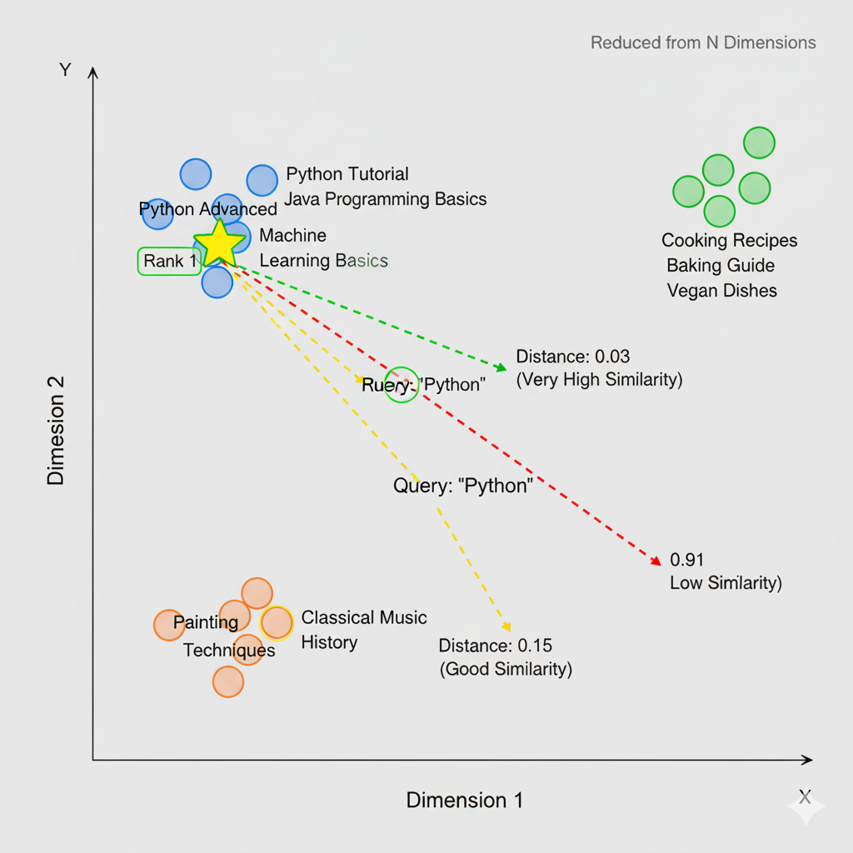
How Similarity Search Works
The Vector Search Process
1. INDEXING
Documents → Embedding Model → Store vectors
Doc 1: "Python tutorial" → [0.2, -0.4, 0.6, ...] → Store
Doc 2: "Java programming" → [0.3, -0.5, 0.5, ...] → Store
Doc 3: "Cooking recipes" → [-0.8, 0.9, -0.2, ...] → Store
2. SEARCHING
User Query: "learn Python" → [0.21, -0.42, 0.58, ...]
Compute distances to ALL stored vectors:
- Distance to Doc 1: 0.03 ✓ (very close!)
- Distance to Doc 2: 0.15 (somewhat close)
- Distance to Doc 3: 0.91 (far away)
Similarity Metrics
- Cosine similarity: Angle between vectors (most common)
- Euclidean distance: Straight-line distance
- Dot product: Vector multiplication

Slide 7
Embedding Quality Matters
🏛 EVERLAW (Legal Discovery - 1.4M documents)
87% accuracy
Model | Provider | MTEB | Dims | Price/1M
stella_en_1.5B_v5 | NovaSearch | 71.54 | 1024-8192 | Free (OSS)
gemini-embedding-001 | Google | 68.32 | 3072 | $0.15
text-embedding-3-large | OpenAI | 64.6 | 3072 | $0.13
text-embedding-3-small | OpenAI | 62.3 | 1536 | $0.02
💬 MINDLID
82% 3 recall
📧 INTERACTION CO (Email Assistant - 100 emails)
21.45s embedd
https://huggingface.co/spaces/mteb/leaderboard

Slide 8
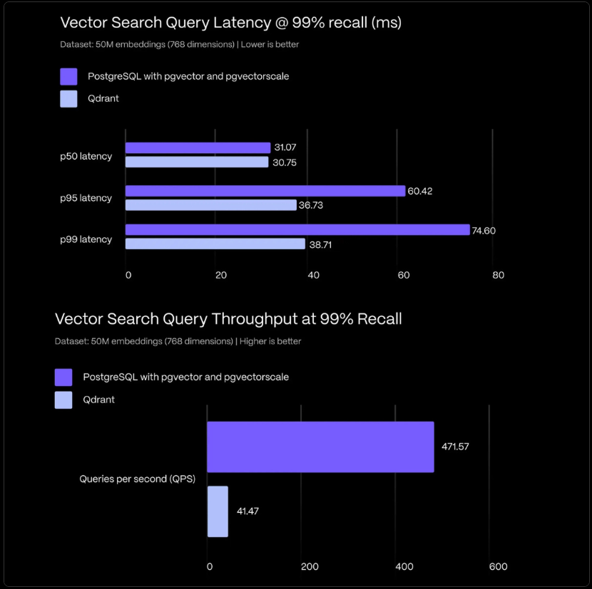

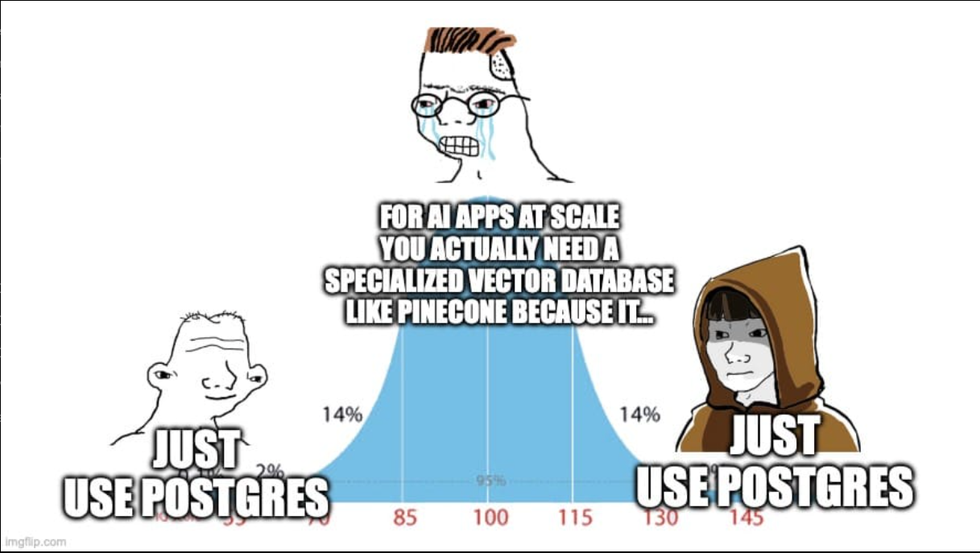
PostgreSQL Revolution

Slide 9



From MVP to Scale
Mid Size High-Performance Vector Search
Architecture & Performance
- Embedded database (runs in-process with your application) - 112 QPS at 10M vectors - Python and JavaScript SDKs - Open-source (Apache 2.0 license)
Memory Optimization:
- In-memory and persistent storage modes - Optimized for datasets under 1M vectors - Simple distance functions (cosine, L2, inner product)
Advanced Capabilities:
- Zero-configuration setup (pip install chromadb) - Metadata filtering - Multiple collection support
Architecture & Performance
- Rust-based for maximum speed - 626 QPS at 99.5% recall (1M vectors) - Sub-3ms p95 latency - Open-source (Apache 2.0 license)
Memory Optimization:
- Binary Quantization: 40x memory reduction - Scalar quantization - Product quantization
Advanced Capabilities:
- Native hybrid search (dense + sparse vectors) - Advanced payload filtering - Distributed architecture for horizontal scaling - RESTful and gRPC APIs
Architecture & Performance
- Built for massive scale (billions of vectors) - 2,098 QPS at 100% recall (10M vectors) - Sub-10ms latency on performance configurations - Open-source (Apache 2.0 license)
Memory Optimization:
- Int8 compression: 75% memory savings - RabitQ 1-bit quantization - Multiple quantization strategies
Advanced Capabilities:
- GPU acceleration support - Up to 100,000 collections per cluster - Distributed architecture with query node separation - Multiple distance metrics and index types (HNSW, IVF, DiskANN)
Notes:
Already using PostgreSQL?
└─ ✅ pgvector + pgvectorscale (471 QPS, 75% cheaper)
Need maximum performance at smaller scale (~10M vectors)?
└─ Qdrant (626 QPS, sub-3ms)
Billion-scale vectors or need GPU acceleration?
└─ Milvus/Zilliz Cloud (2,098 QPS, sub-10ms)
Want zero ops?
└─ Pinecone or Weaviate Cloud
Prototyping/MVP?
└─ Chroma (embedded, free)

Slide 10
Advanced RAG patterns

Slide 11



The Multi-Hop Reasoning Problem
Complex Query:
"What are the regulatory implications of our Q3 marketing
strategy for the European market?"
Traditional RAG fails
Problem: Can't connect the dots!
Marketing → Budget → Compliance → GDPR → Europe
Retrieves isolated chunks:
- "Q3 marketing strategy increased social media spend"
- "European market regulations overview"
- "GDPR compliance requirements"
This is where we need Graph RAG

Slide 12
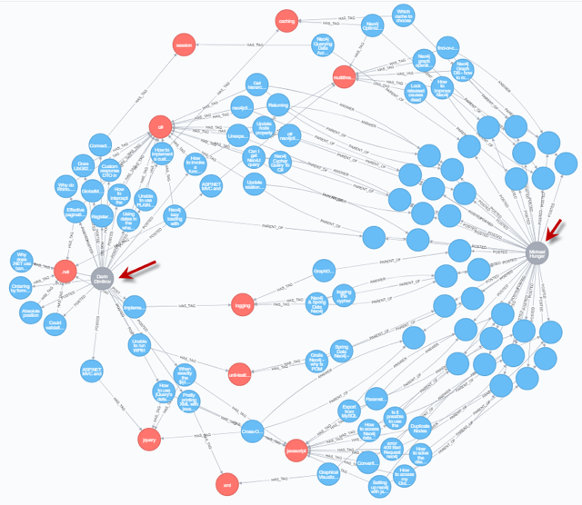
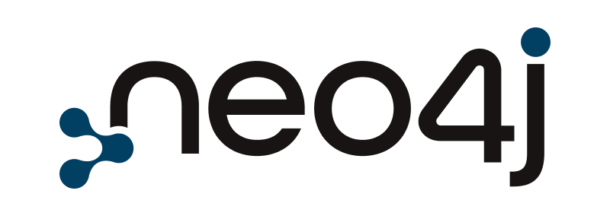
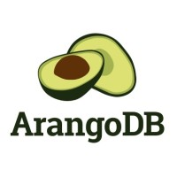

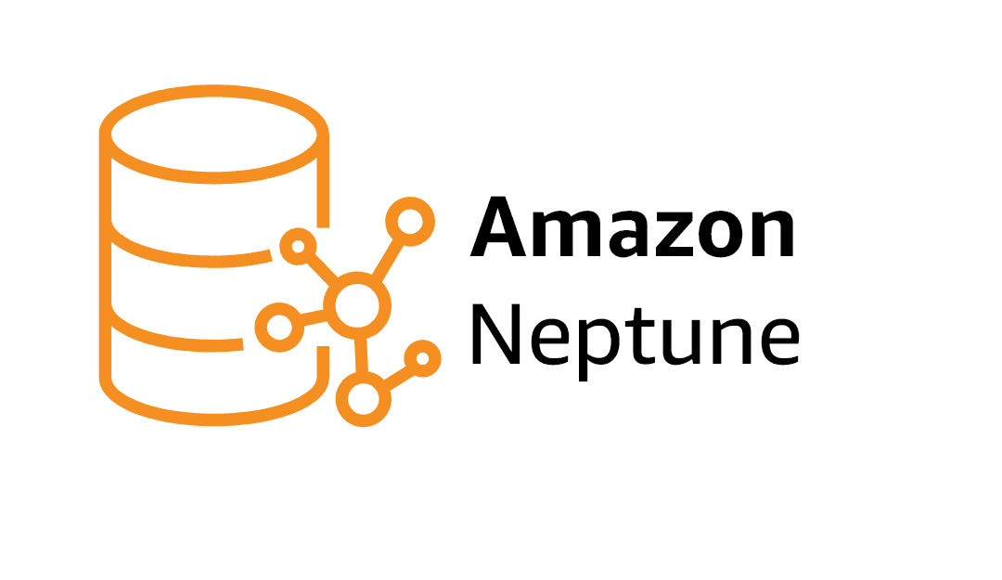
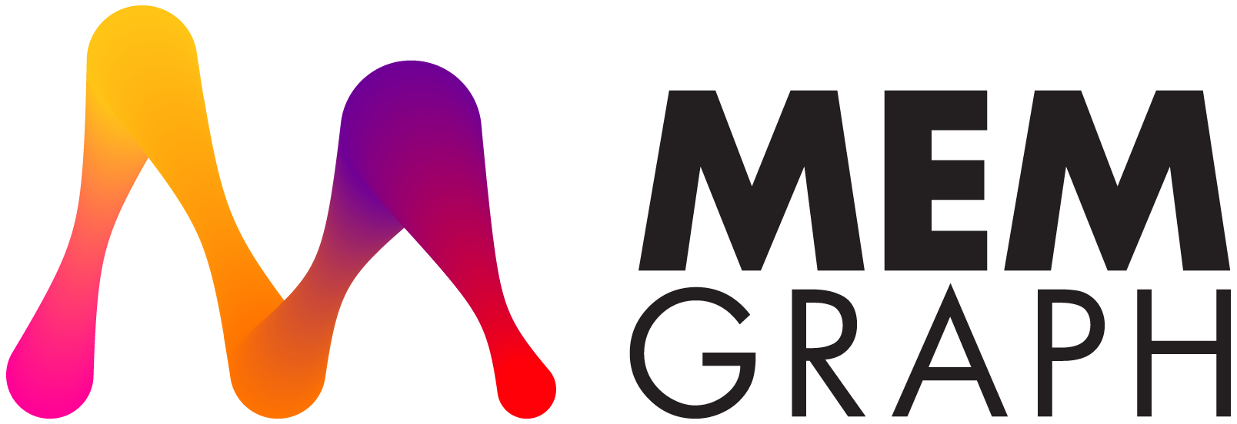

GraphRAG Solution
Notes:
How Graph RAG Works:
1. Knowledge Graph: Entities + Relationships
[Marketing Strategy] → [REQUIRES] → [Budget]
[Budget] → [AFFECTS] → [Compliance]
[Compliance] → [INCLUDES] → [GDPR]
[GDPR] → [APPLIES_TO] → [Europe]
2. Multi-hop traversal follows these connections
3. Community detection groups related concepts
Microsoft GraphRAG Performance:
Source: Microsoft Research + Fortune 500 deployments
Multi-hop accuracy: 87% vs Traditional: 23% (3.8x better)
Response completeness: 94% vs 67% (+27 points)
Context preservation: 91% vs 34% (2.7x better)
✅ Use When:
- Complex multi-hop questions
- Need explainable paths
- Multiple related entities
❌ Don't Use When:
- Simple fact-finding (overkill)
- Limited budget (expensive graph construction)
Source: microsoft.com/research/project/graphrag

Slide 13
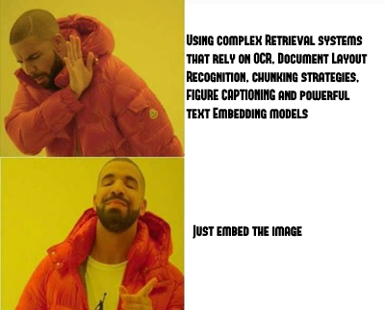
The PDF Processing Problem
Traditional RAG Pipeline for PDFs
OCR → Errors with complex layouts
Layout detection → Misses table structures
Figure captioning → Expensive specialized models
Chunking → Loses visual context
Embed text only → No visual information
Result: 40-60% information loss on visual documents

Slide 14
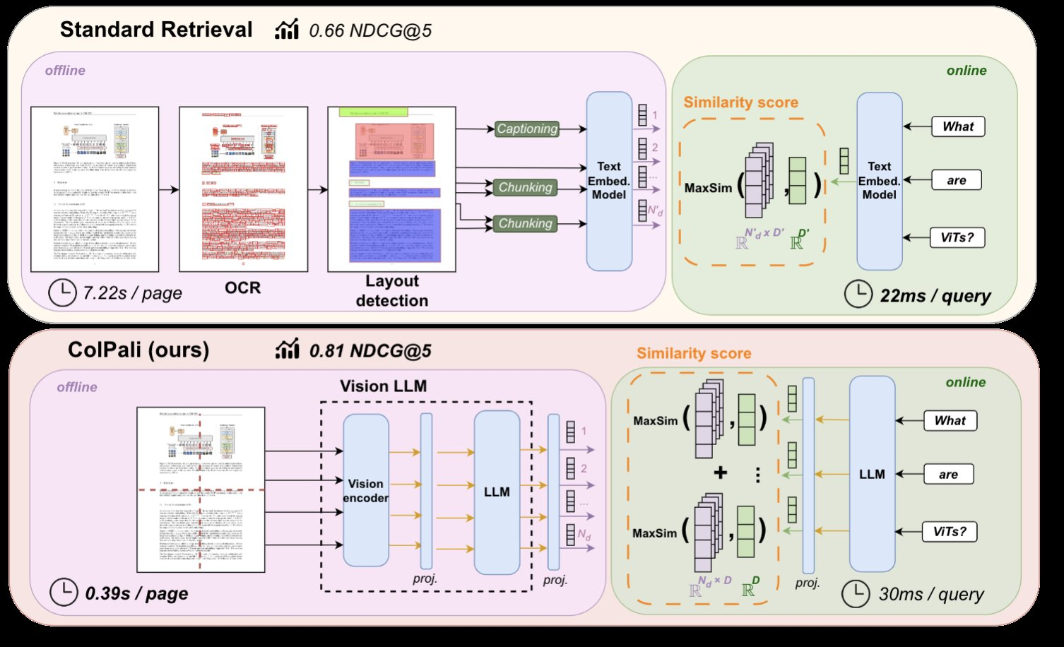
ColPali Revolution
Treat Pages as Images (No OCR!)
Architecture
PaliGemma-3B Vision Language Model
32×32 patches = 1,024 patch embeddings per page
ColBERT late interaction matching

Slide 15
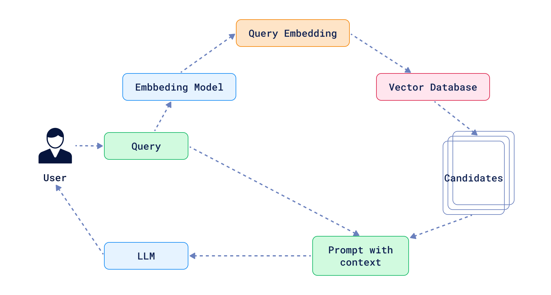
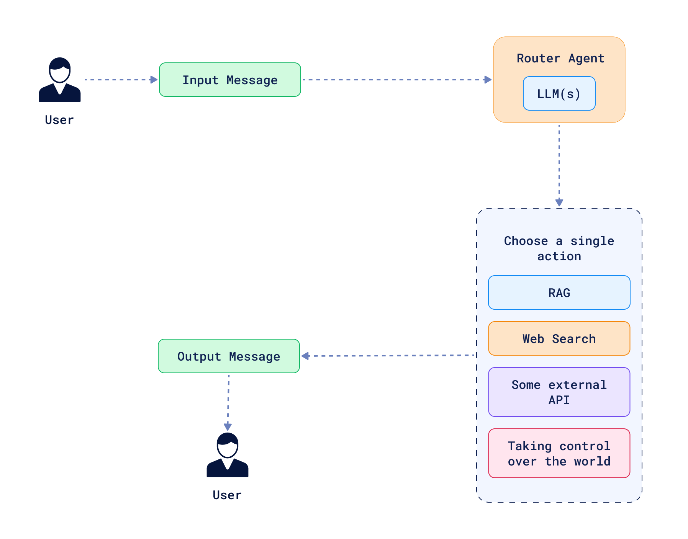
What Makes RAG "Agentic"
Notes:
Traditional RAG: Fixed pipeline (same steps always)
User Query → Retrieve → Generate → Answer
Agentic RAG: LLM decides dynamically
User Query → Agent Decides:
├─ Which tool? (vector DB, web search, SQL)
├─ Query clear? (may need rewrite)
├─ Results relevant? (may retry)
└─ Need more steps? (multi-hop)
Key Capabilities:
- Dynamic routing based on query type
- Self-correction and refinement
- Multi-step reasoning
- Tool orchestration

Slide 16
Agentic Patterns
Query Routing
User: "What's the latest on AI regulation?"
Router: "latest" detected → Route to Web Search ✓
User: "What's our Q3 marketing budget?"
Router: "our" = internal → Route to Vector DB ✓
Query Decomposition
Complex: "Compare our Q3 to industry and predict Q4"
Agent breaks down:
"Our Q3 metrics" → Internal DB
"Industry Q3 benchmarks" → Web Search
"Q4 factors" → Internal DB
Then synthesizes all results
Self-Correction
Retrieval
Grade docs
Score < threshold?
Rewrite query
Retry
Grade again
Use When: Queries span sources, complexity varies
Don't Use: Latency-critical (<500ms SLA), simple retrieval
Notes:
✅ Pros: - Handles complex, varied queries - Adaptive and self-correcting - Multiple data sources
❌ Cons: - 2-5x latency overhead (200ms → 1000ms) - Higher costs (3-5x LLM calls per query) - Complex debugging

Slide 17
Hybrid Search + Reranking Power
Vector-only: Misses exact matches, acronyms
BM25-only: No semantic understanding
Microsoft Azure AI Search Benchmarks:
- Vector-only: 43.8 NDCG@3
- Hybrid: 48.4 NDCG@3 (+10.5%)
- Hybrid + Reranker: 60.1 NDCG@3 (+37.2%)
Anthropic Contextual Retrieval Study:
- Baseline failure rate: 5.7%
- Hybrid + Reranker: 1.9%
- 67% reduction in retrieval failures
2 Stage Architecture Rerank:
Stage 1:
Similarity search → Top 100
Stage 2:
Re-ranking pipeline → Top 5-10
Use When: Queries span sources, complexity varies
Don't Use: Latency-critical (<500ms SLA), simple retrieval
Notes:
✅ Pros: - Handles complex, varied queries - Adaptive and self-correcting - Multiple data sources
❌ Cons: - 2-5x latency overhead (200ms → 1000ms) - Higher costs (3-5x LLM calls per query) - Complex debugging

Slide 18
Production readiness

Slide 19

Production Best Practices
Do’s
Don’ts
1. Use Hybrid Search (vector + BM25) as baseline
2. Implement metadata filtering (security-critical)
filter = {"department": "finance", "access_level": user.role}
3. Monitor retrieval quality (recall@k, NDCG)
Tools: TruLens, LangSmith, DeepEval
4. Keep embeddings fresh (re-index on doc changes)
5. Evaluate systematically (not "vibes-based")
1. Vector-only search (use hybrid)
2. Ignore access controls (data leakage = lawsuit)
3. Overload context window (keep <50%)
4. Skip evaluation frameworks (doesn't scale)
5. Neglect data freshness (stale = wrong answers)
Notes:
Test scenarios in P&G creation. Generally, copy and paste the description from the story and ask for 5-6 test cases + then another 5 negative. But the TC then needed to be rewritten a little bit and adjusted to the project.
Useful for:
Test Cases titles generation
Test Scenarios generation (BDD)
Metrics suggestions and calculation
The structure of the Test Plan/Test Strategy suggestion/generation
Test process improvements suggestions
Tests optimisation/prioritisation
BE tests + automation tests in POSTMAN
Requirements Analysis
Test Data generation
Test Report generation
Not Useful for:
Manual testing itself (Exploratory, UI/UX, Compatibility, UAT, Non-functional)
Business specific corner cases generation
Bugs reporting/validation
Risks Assessment

Slide 20
